Slide 2
+ Encompass +
A Homeless Ministry of the
Santa Clara Valley Lutheran Parish

Slide 3
The need . . .

Slide 4
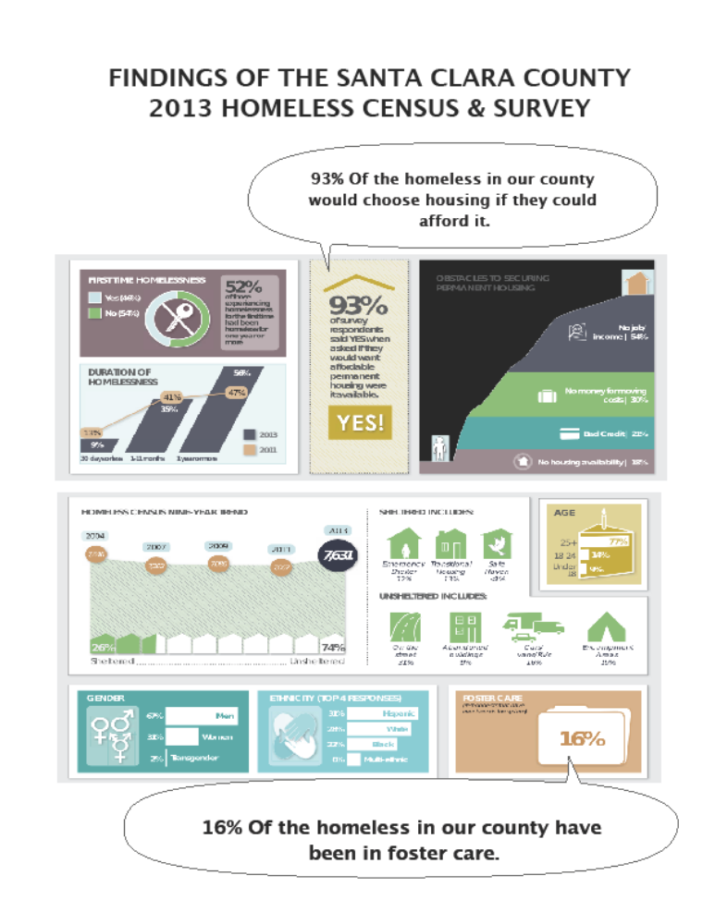

Slide 5
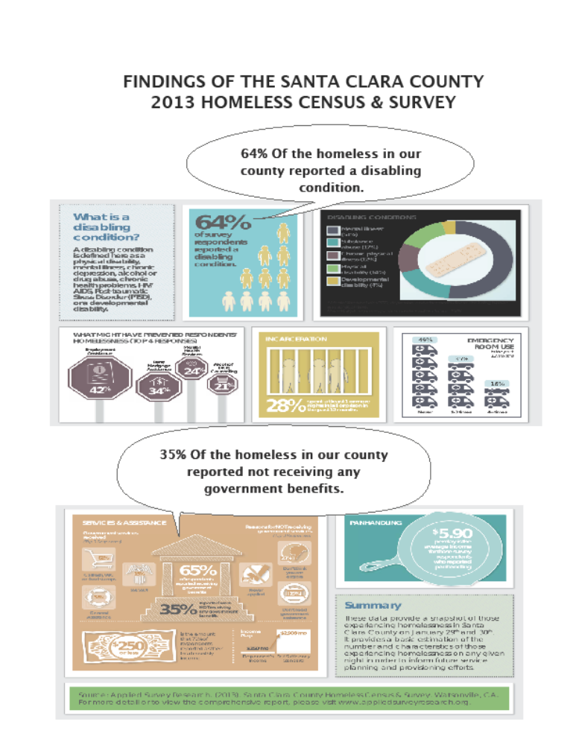

Slide 6
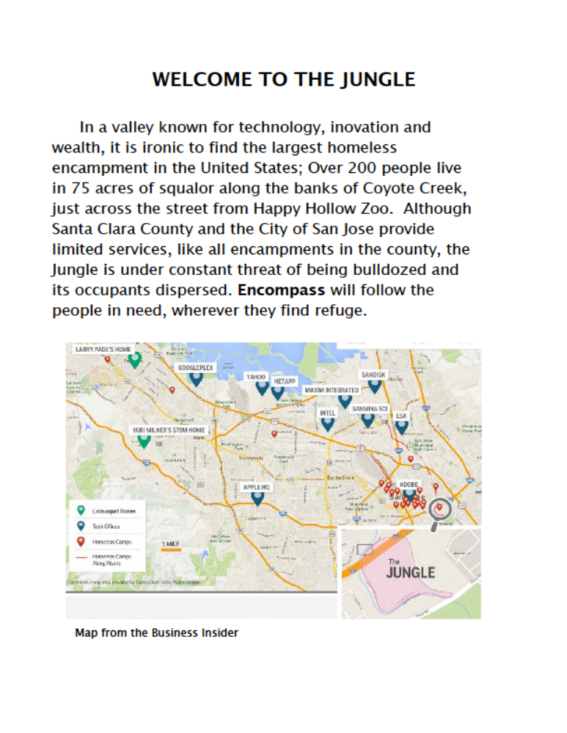
These red dots show the locations of 21 known homeless camps in Santa Clara County.

Slide 7
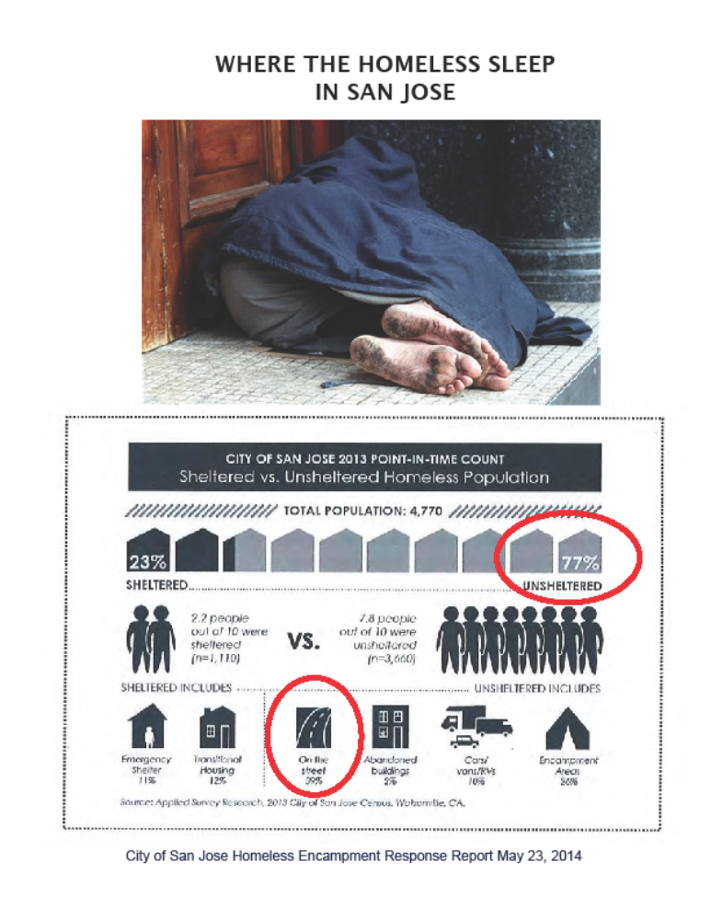

Slide 8
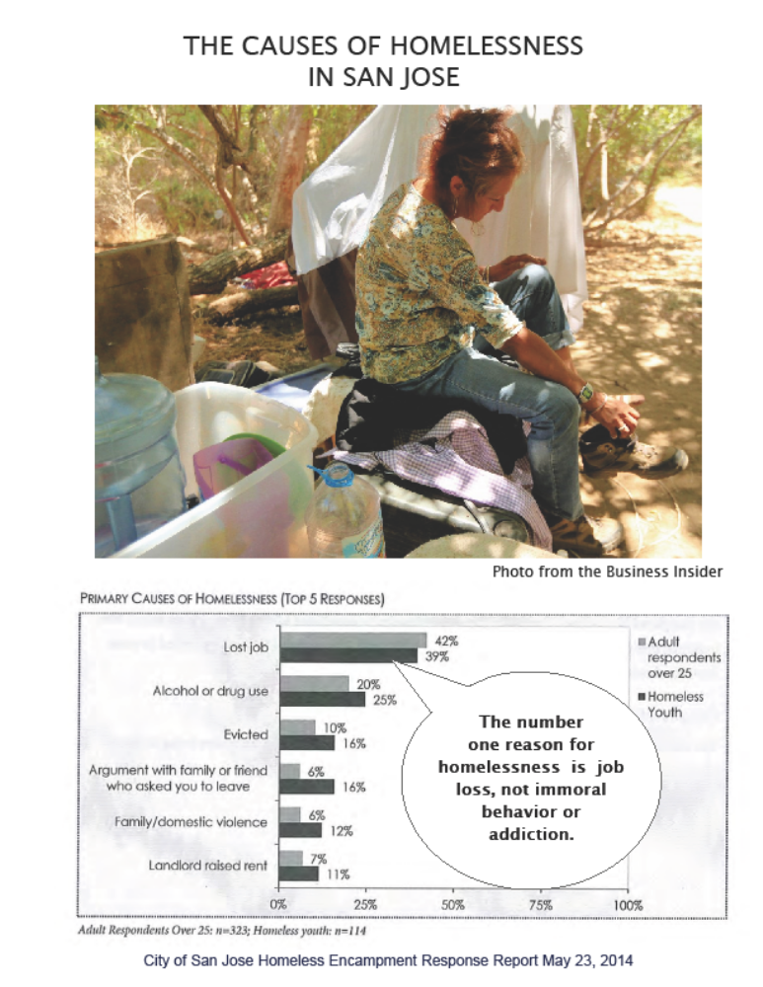

Slide 9
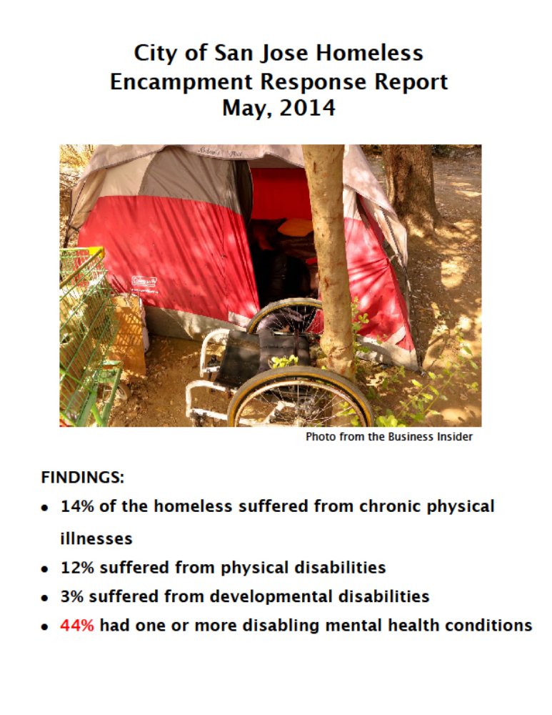

Slide 10
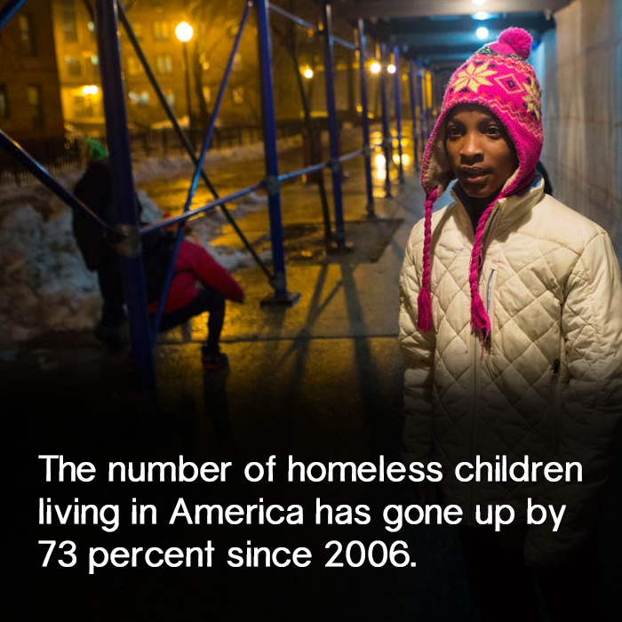
HomelessYouth. . .
The Mercury News cites (October 12, 2013 “Fears of another ‘Lost Generation’: Youth homeless numbers rising”) reported that Santa Clara County homeless young people (25 yrs. and younger) numbered 1,266. This is almost doubling of homeless youth in two years.

Slide 11


On May 23, 2014, the City of San Jose reported at what age people first experience homelessness:
Ages %
4 – 13 14%
14 – 17 28%
18 – 21 46%
22 – 24 13%

Slide 12
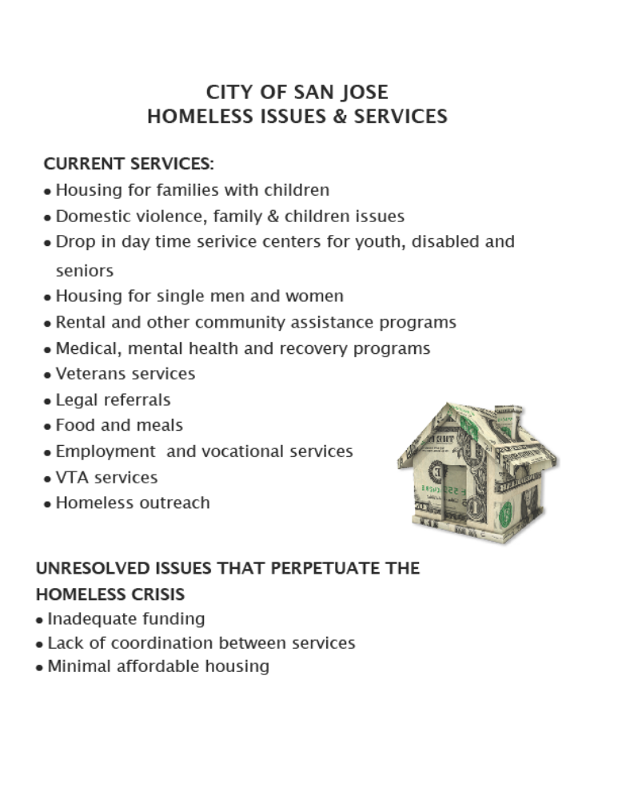
THERE ARE SERVICES OFFERED TO THE HOMELESS
There are many government services provided to the homeless…
Housing for families with children
Domestic violence, family & children issues
Drop in day time service centers for you, disabled and seniors
Housing for single men and women
Rental and other community assistance programs
Medical, mental health and recovery programs
Veterans services
Legal referrals
Food and meals
Employment and vocational services
VTA services
Homeless outreach
f

Slide 13
. . .but they are there are still seemingly intractable problems for the homeless.
Inadequate funding
Lack of coordination between services
Insufficient affordable housing

Slide 14
And . . .
no church in their midst

Slide 15
Why don’t they go to church?
While almost all of the homeless cling to God; for hope, help and comfort, they rarely feel comfortable in a church for a worship service.
Where everyone else smells nice.

Slide 16
The Ministry

Slide 17
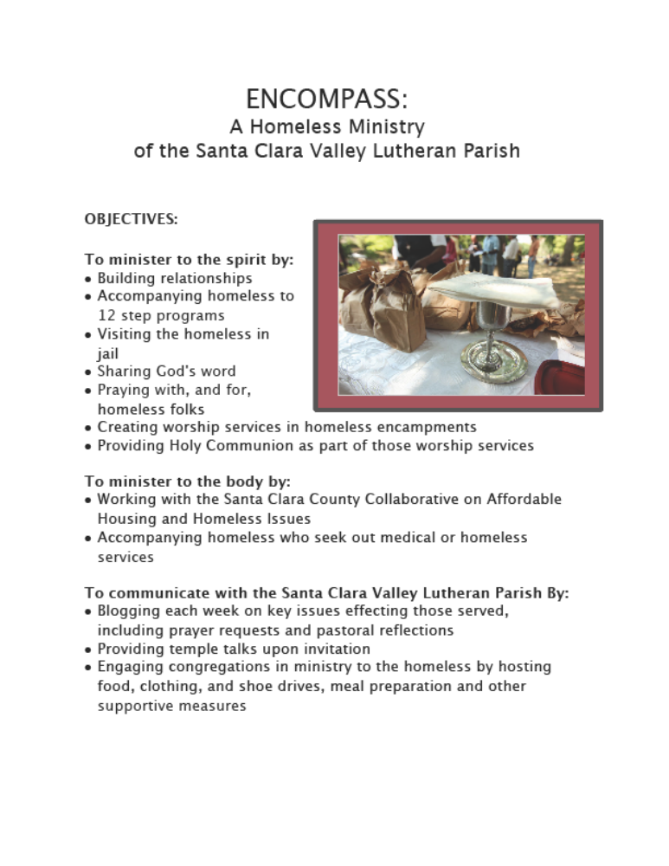

Slide 18

One hopeful group taking action on local homelessness
Is the Santa Clara County Collaborative on Affordable House and Homeless Issues.
Encompass Ministry will work with the Collaborative
Bring information to the Parish and
Coordinating parish volunteers and monies to the collaborative.

Slide 19
+ My Status +
I am a TEEM graduate, certified for Call.
Sadly, the congregation that committed to my TEEM training and eventual Call, collapsed.
Currently, I volunteer 20 hrs. /wk working in local homeless camps; especially in the Jungle.
I also spend 15 hrs. /wk at Hope Lutheran teaching, preaching and assisting in youth ministry.

Slide 20
+ The Vision +
In discussions between leaders at Hope and the Parish, there is a vision and desire to Call me to serve in a full time Call split between:
Hope Lutheran as an Associate Pastor
Encompass Ministry as Founding Pastor

Slide 21
+ The Call+
We are praying that congregations of the Parish and other churches and individuals
be willing to partner with Hope in this Call and providing the financial support for the Encompass Ministry portion of the Call.
If funding can be developed, then Hope Lutheran will vote to Call me to a 3-year Term Call with 50% of my time devoted to the Parish’s Encompass Ministry.

Slide 22
+ The Structure +
Hope will issue the Call and then release 50% of my time back to the parish.
Hope will provide administration of finances , development of funding, accounting, insurance, etc.
The Encompass Supervisory Board will be made up of:
  + Pr. Anne Carlson, Pr. Ernest Brooks & Pr. John Sullivan
  as well as members from the supporting congregations.

Slide 23
+ Supervisory Board +
Supervisory Board duties will include:
Interpretation of the program to other entities (a group to speak on the ministry’s behalf)
Audit of expenses
Set policy for outreach ministry
Audit programs
Job description
Setting up of the Board of Directors

Slide 24
+ Funding +
Through a special gift, Hope can support 50% of my salary and my entire housing allowance.
The remainder of my salary, along with 50% of Portico Retirement and benefits will need to come from the Parish and other sources to help develop the Encompass Ministry to the Santa Clara County Homeless.

Slide 25
+ The Cost +
The annual cost of this ministry involves compensation and program expenses.
The entry level for a first Call is 50K salary plus benefits: $82,300.
Split between Hope and the SCVLP, the amount of $41,150 each.
Estimated program expenses for the first year will be $500 for Word and Sacrament supplies.
As additional needs arise, such as wheelchairs, clothing, food vouchers, etc., they will be shared with the congregations of the parish.

Slide 26
+ What are we asking for? +
Support from churches for the
Encompass Ministry to Santa Clara County Homeless
in the amount of:
$41,150
We realize that today as an Assembly Voting Member you may not be to speak on behalf of your church.
Please, take and return an …
“INTENTION/PLEDGE FORM”

Slide 27
+ $41,150 is a Big Number +
But already three churches have expressed their interest in supporting the Encompass Ministry and are considering significant gifts:
+ New Creation Lutheran Church, San Jose +
+ Hope Lutheran Church, Santa Clara +
+ St. Francis Lutheran Church, San Francisco +
Please, take and return an …
“INTENTION/PLEDGE FORM”.

