Slide 1
Sacred Digital Connections
Using Digital Media as a
Tool for Ministry

Slide 2

Desta Goehner
Director of Congregational Relations
About.me/DestaG
Twitter & Instagram: @DestaG
Desta@CalLutheran.edu
#CLUConnect

Slide 3
Who are you?
Your experience with digital and/or social media?
- Personally
- As a congregation

Slide 4

May the words of my mouth, and the meditations of my heart in this place – our thoughts, our notes, our tweets, our Facebook and Instagram posts – be acceptable in your sight, O God, because you are our Rock and our Redeemer. Amen.
- Pastor Jason Chestnut (@crazypastor)

Slide 5

What is Digital Media
Content that can be created, viewed, distributed, modified and preserved on computers and mobile devices.
Internet, web-based
Social Media
Email
Digital newsletters
Blogs
Texting
Mobile apps

Slide 6
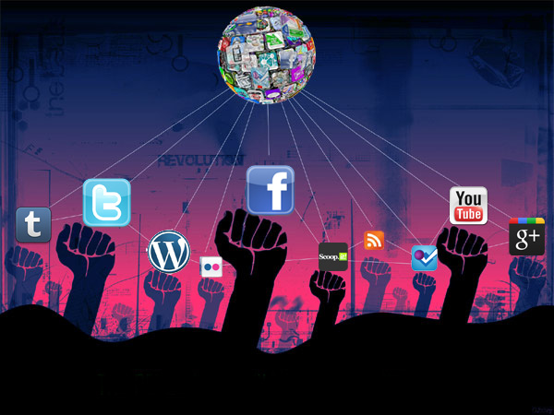
Changing the Way We Live
Digital social media and mobile technologies have changed the way most people interact
with others,
communicate, organize,
and participate in communities.

Slide 7
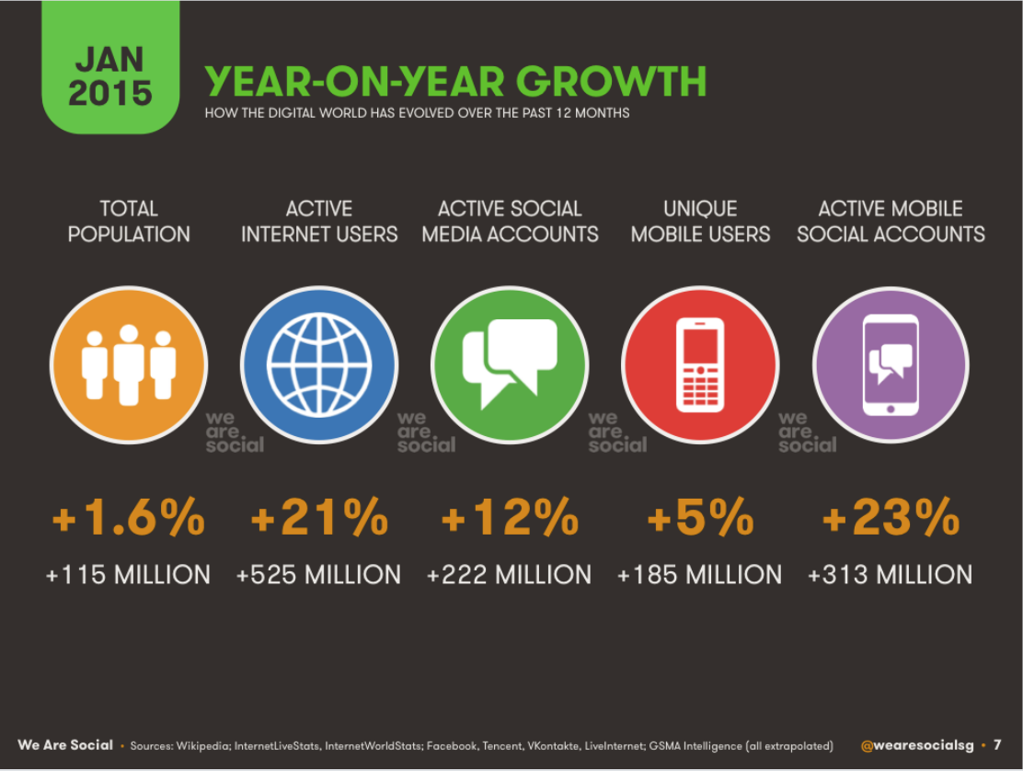
Digital Media Growth
Just Last Year:
Worldwide social media users exceeded 2 billion
Global internet users passed 3 billion
Active mobile connections surpassed the total world population in December

Slide 8
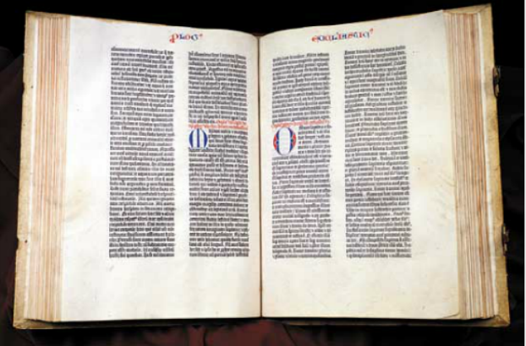
The Gutenberg Press of Today
The internet and social media are the Gutenberg Press of this century.
Powerful tools
Share information
Listen to and build community
Spread the Good News (like Martin Luther did)
Above: The first document printed on the Gutenberg Press – the Holy Bible

Slide 9
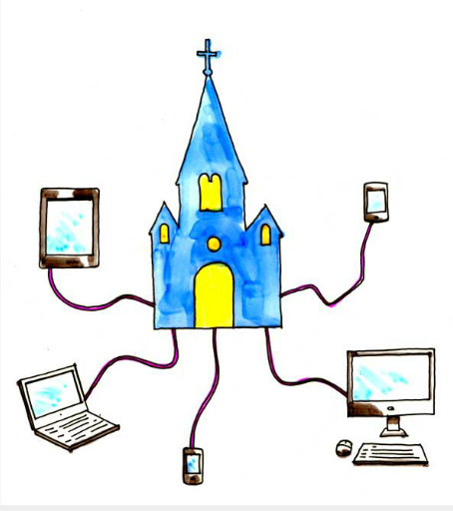
Technology & Ministry
Rapid cultural and technological changes have changed the context for ministry.
We have the opportunity to use ever-changing social media tools to share the Good News in new ways.
Luther bridged the gap between clergy and lay people
Social media can do the same!
Social media is an evangelism tool.

Slide 10

What is Social Media?
Web-based tools for interaction that allow people to be in conversation and share content such as photos, videos, and links to resources.
Popular social media platforms:
Facebook
Twitter
Instagram
YouTube
SnapChat
Pinterest
Periscope
Tumblr
and many more...

Slide 11

Spreading the Good News
Social media tools can be used to:
Manage and monitor public perception of your mission
Magnify your ability to listen to your congregation and community
Magnify your ability to proclaim God’s word
Share conversations and content with young people, young adults the homebound, and spiritual seekers within and beyond "church-the-building"

Slide 12
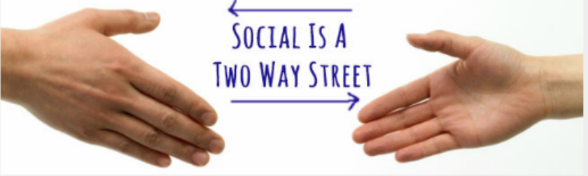
Two-Way Street
Churches used to communicate like a one-way street – giving information and others receiving it, with limited opportunities for feedback from the community.
With social media, communication is open in both directions, and it becomes a conversation.
Social media can empower the entire community to be an extension of the Church – to open doors for one another.

Slide 13
Social Media is both a Stethoscope and a Megaphone
A stethoscope: magnifying your ability to listen to your youth group and community
A megaphone: magnifying your ability to proclaim God’s word to your community.

Slide 14

Making the Connection
Social Media is a conversation with people online.
It’s about forming relationships.
You become more connected to people, groups, and organizations.
The underlying power in social is not technology. It’s the power that comes from human beings connecting to each other.

Slide 15

"Wherever two or more are gathered in my name,
I am among them." – Matthew 18:20
"Therefore, go and make disciples in my name."
– Matthew 28:19

Slide 16
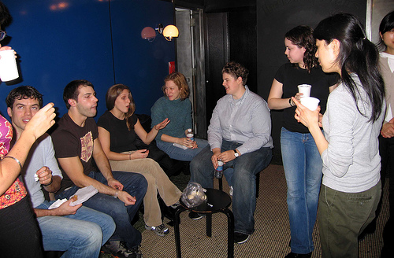
Social Media = A Party

Slide 17

Community Dynamics
Social media is real community. If it occurs in real community, it will occur in virtual community.
    Growth
    Cliques
    Conflict
    Change
Everything happens faster in virtual community.
What becomes possible once we accept the principle that virtual community is real community?

Slide 18
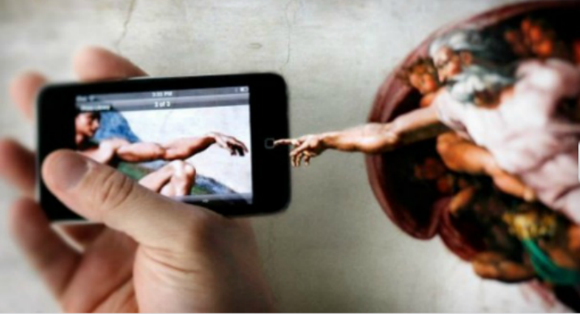
Seeking Out the Community
People used to come to the pulpit,
now we need to take the pulpit to the people.
Think of all the waiting that people do these days...in line, waiting for parents/kids, waiting for appointments, after school...
Use social media to share the story of what your church is about.
Reach out to your community.

Slide 19
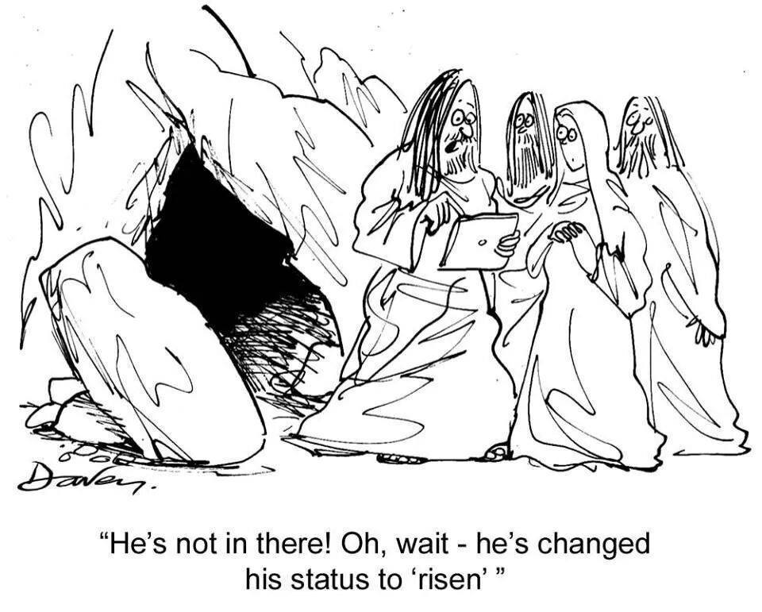
People want…
Information
Inspiration
Connection
Humor!
To be part of something
Easy to share with others

Slide 20
WHAT SHOULD PEOPLE KNOW
ABOUT YOUR CHURCH?

Slide 21
Content for Social Media
Where can you find good stories at church?
Where can you find good stories in your community?
Where can you find good content in social media?

Slide 22
Using Social Media in Worship
What happens in worship that we can share?
Permission has to be given from you.
Name it, claim it, permit it, encourage it.

Slide 23
Christ has no online presence but yours,
No blog, no Facebook page but yours.
Yours are the tweets through which love touches the world.
Yours are the updates through which hope is revealed.
Yours are the posts through which the Gospel is shared,
Christ has no online presence but yours,
No blog, no Facebook page but yours.
- Written by Meredith Gould, inspired by St. Teresa of Avila

Slide 24

Digital Assistant Ministers
Take the Pulpit to the people! (Worship & Events)
I’m tweeting.
Ask me about it!

Slide 25
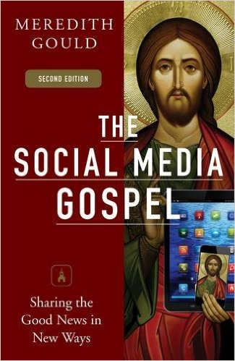
The Basic’s of Social Media
Strategy
  Audience and purpose
  Goals
  Communications audit
Which platforms
  How to safeguard
What’s the story you want to tell?
Curating content
Who will help?
Tag people
Ask questions!
Ask: Is this shareable? Craft your message based on that.

Slide 26
Best Practices
Whole church communications plan
Crisis communications plan
Social Media policy
Create a style guide and brand book
Dealing with conflict
Communications audit
Church social/digital media positions
Easy to share content
Ask people to check in on Facebook
Website that is responsive/mobile friendly
Free Wi-Fi
Photo consent form
Add social media buttons to all church publications
Pick a hashtag (#CLUvine)
Designate one point person
Yelp/Google/Facebook reviews
Give permission in worship
Facebook pages vs. groups
Website captioning sound component (c3 citizen)

Slide 27
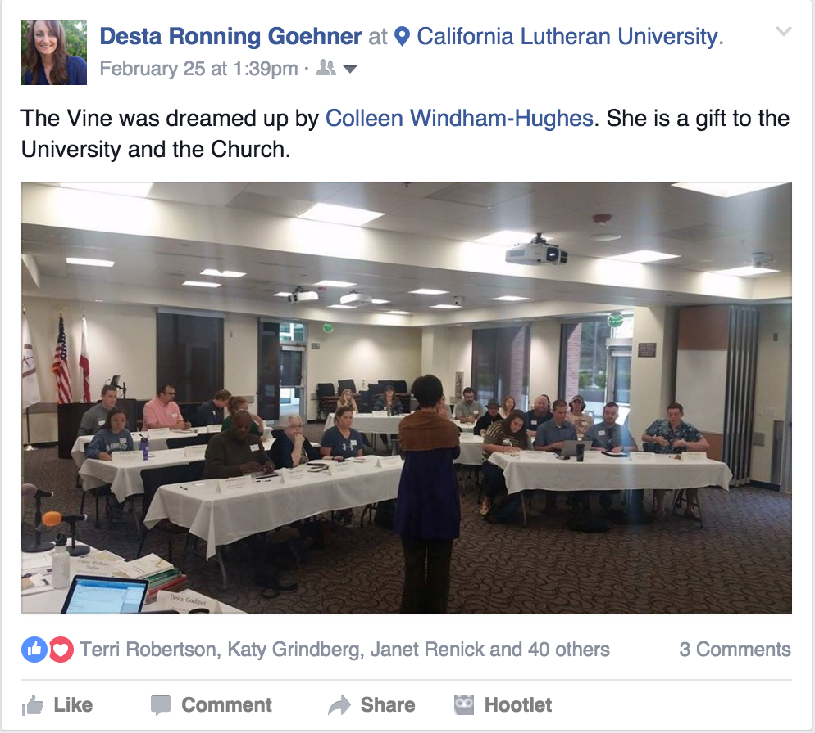
Social Media Examples
#CLUVine
#CLUConnect
#ext16
#ChSocM
#sps17 #spelca
Find a church that does great social media
Find a person who does great social media

Slide 28
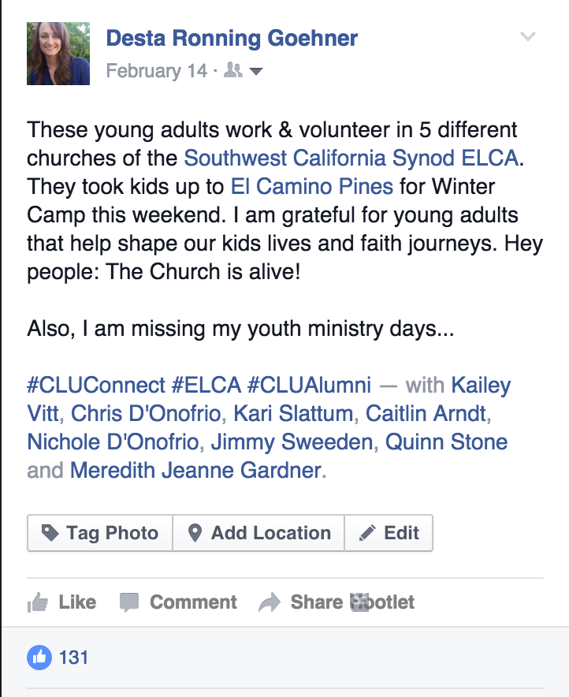
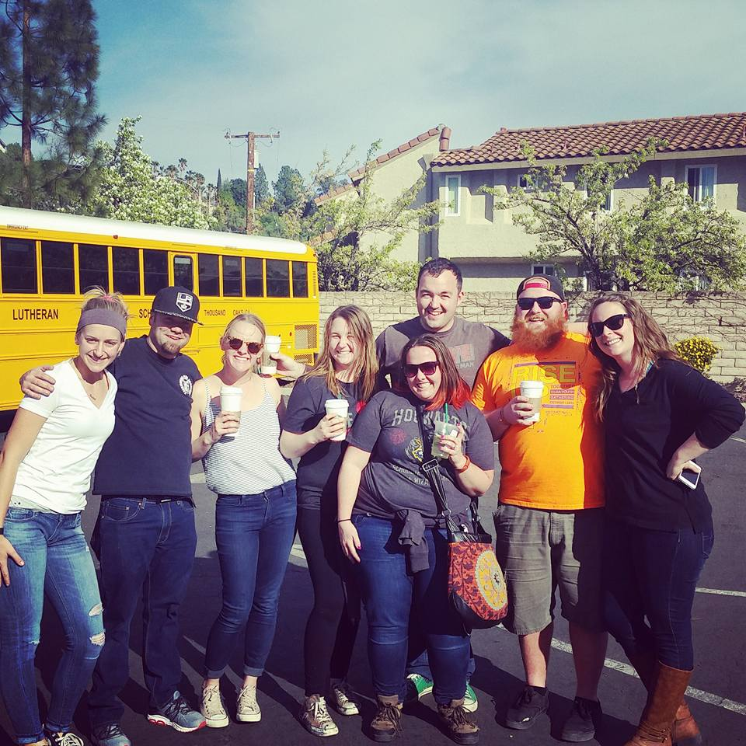
Tag people, places and orgs

Slide 29
Google Calendar
A time-management web application and mobile app created by Google.
Users are required to have a Google Account in order to use the app.
Confirmation
Groups
Bible Studies
Kid’s Personal Events

Slide 30
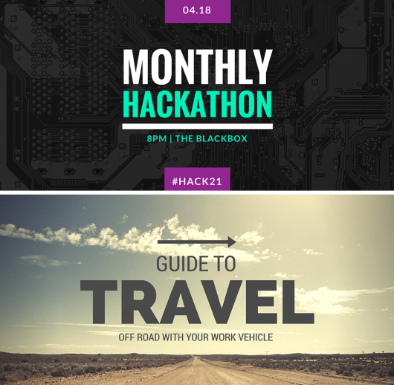
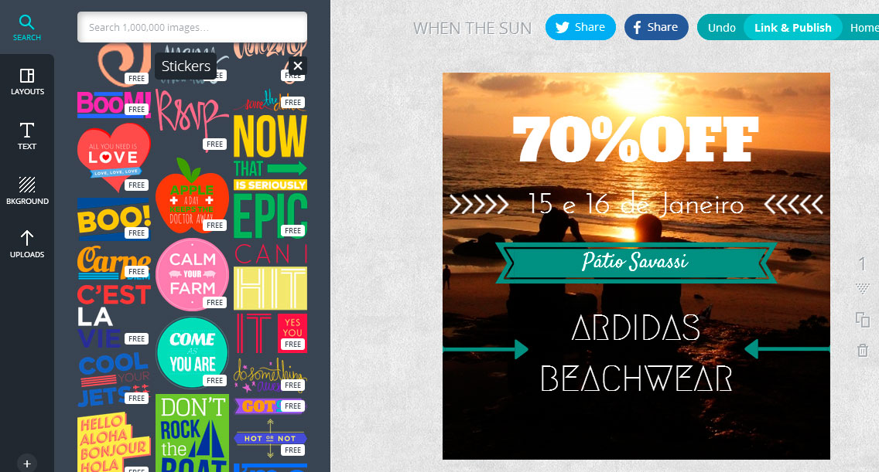
Canva.com
Easily create beautiful designs + documents for web or print: blog graphics, Facebook covers, Instagram posts. Use Canva's drag-and-drop feature and professional layouts to design consistently stunning graphics. Canva makes design simple for everyone!

Slide 31

Easy payments &
Digital Offering Plate
PayPal, Tithe.Ly
Credit Card Reader

Slide 32
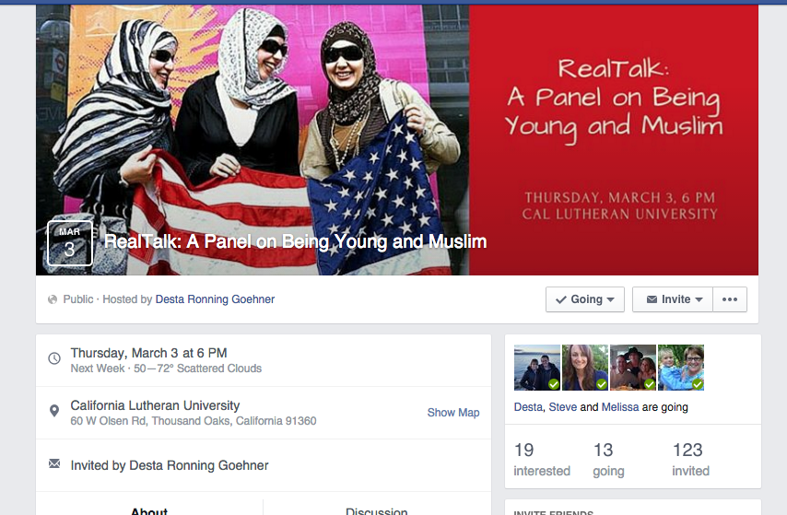
Facebook Events
A calendar-based resource which can be used to notify users of upcoming occasions. Events can be created by anyone, and can be open to anyone or private.
The creator can invite friends, members of a group, or fans of a page.
Events make it easy to share things coming up.

Slide 33
Evite
Online invitations that are free to send and receive.
Easy to create.
Easy to send messages.
“Who else is coming?”

Slide 34
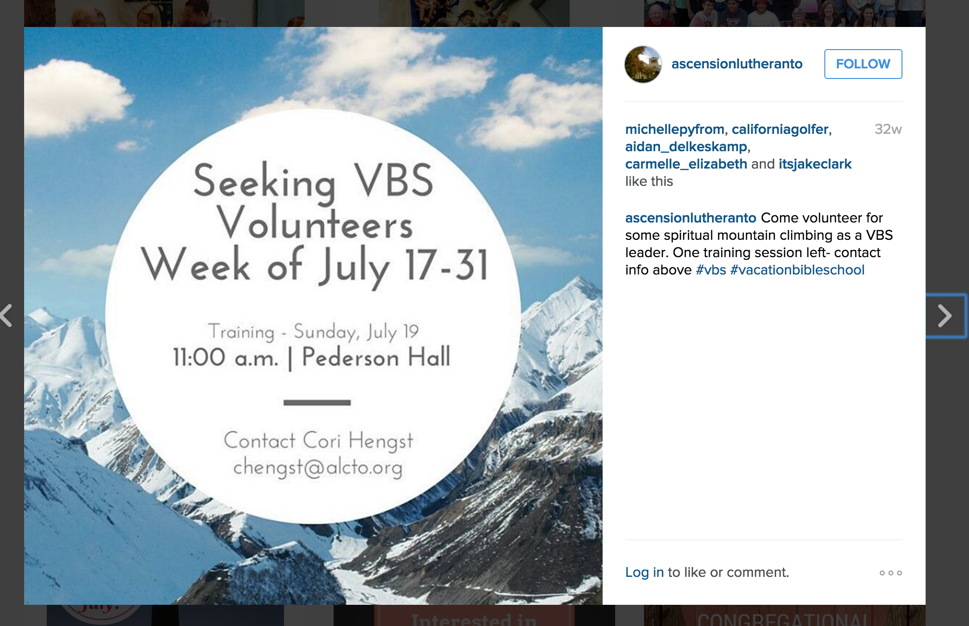
Instagram Reminders

Slide 35
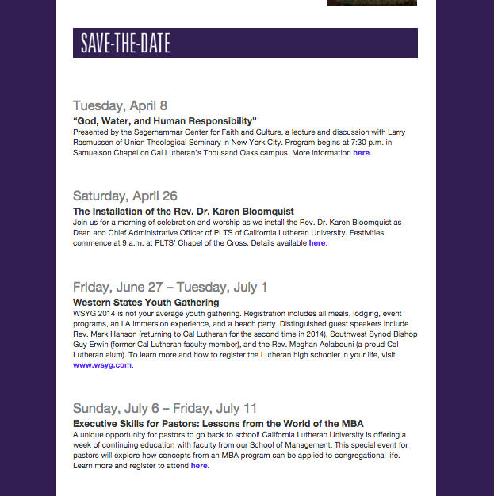
Email
Newsletters
Reminders
Updates
Away messages

Slide 36
GroupMe
Brings group text messaging to every phone, tablet and computer.

Slide 37
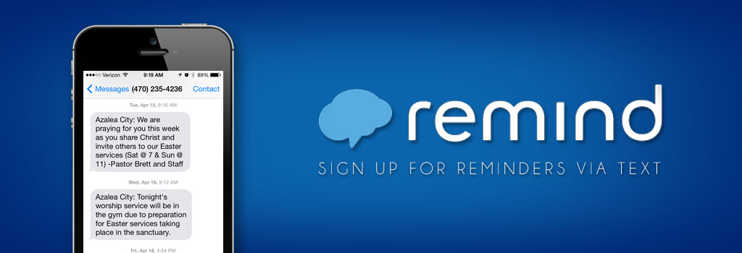
Remind
Website and App
https://www.youtube.com/watch?v=ya-Ft2BMNnQ

Slide 38
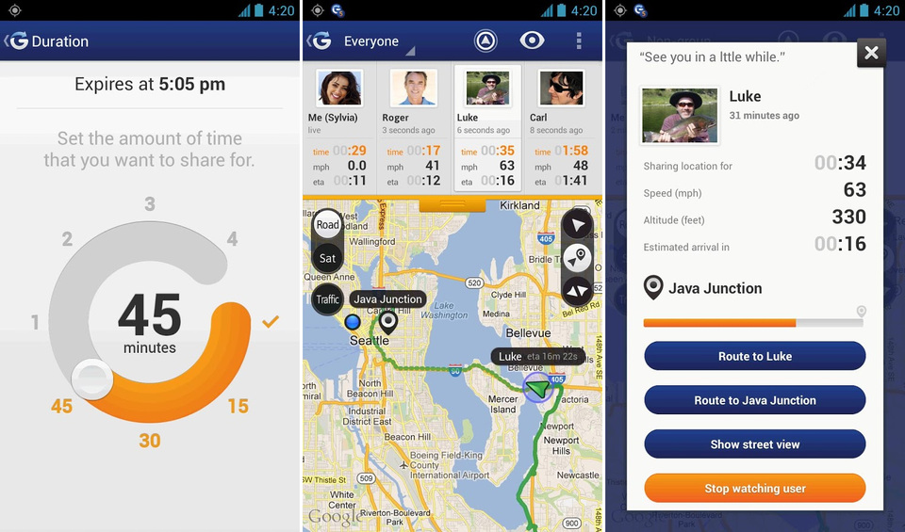
Glympse
Glympse.com - Fast, free, and simple way to share your location in real-time. You set who sees you and for how long.

Slide 39
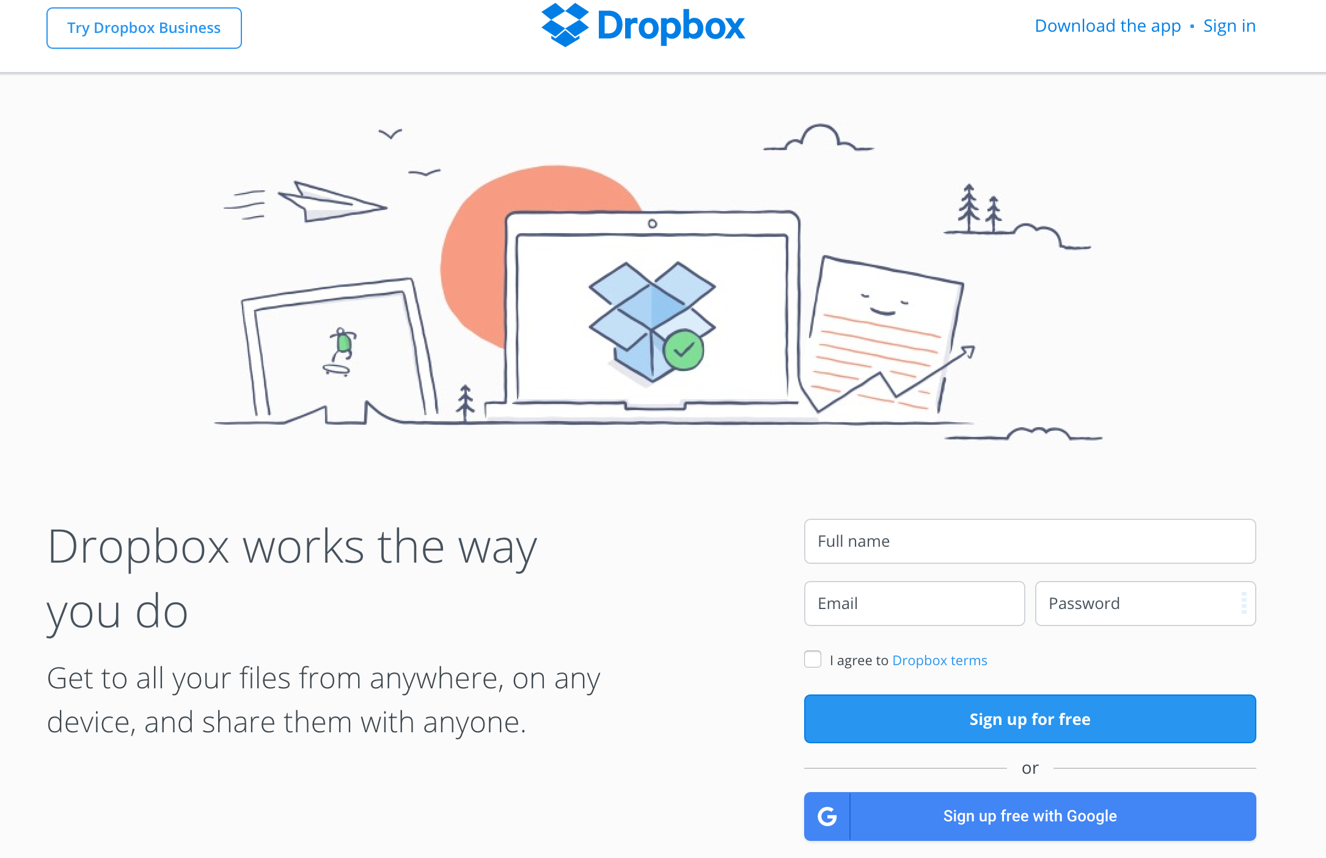
Dropbox
Sharing documents and pictures
Need to send somebody the permission slip quickly?

Slide 40
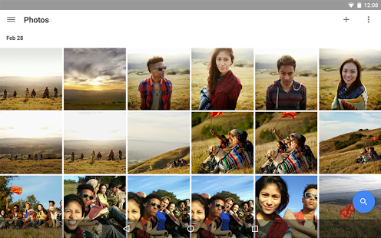
Google Photos
All your photos and videos are backed up safely, organized and labeled automatically, so you can find them fast, and share them how you like. Automatically organized and searchable, you can find photos fast and bring them to life. You can share photos, videos, albums, movies, and stories with anyone, even if they don't use the Google Photos app.

Slide 41
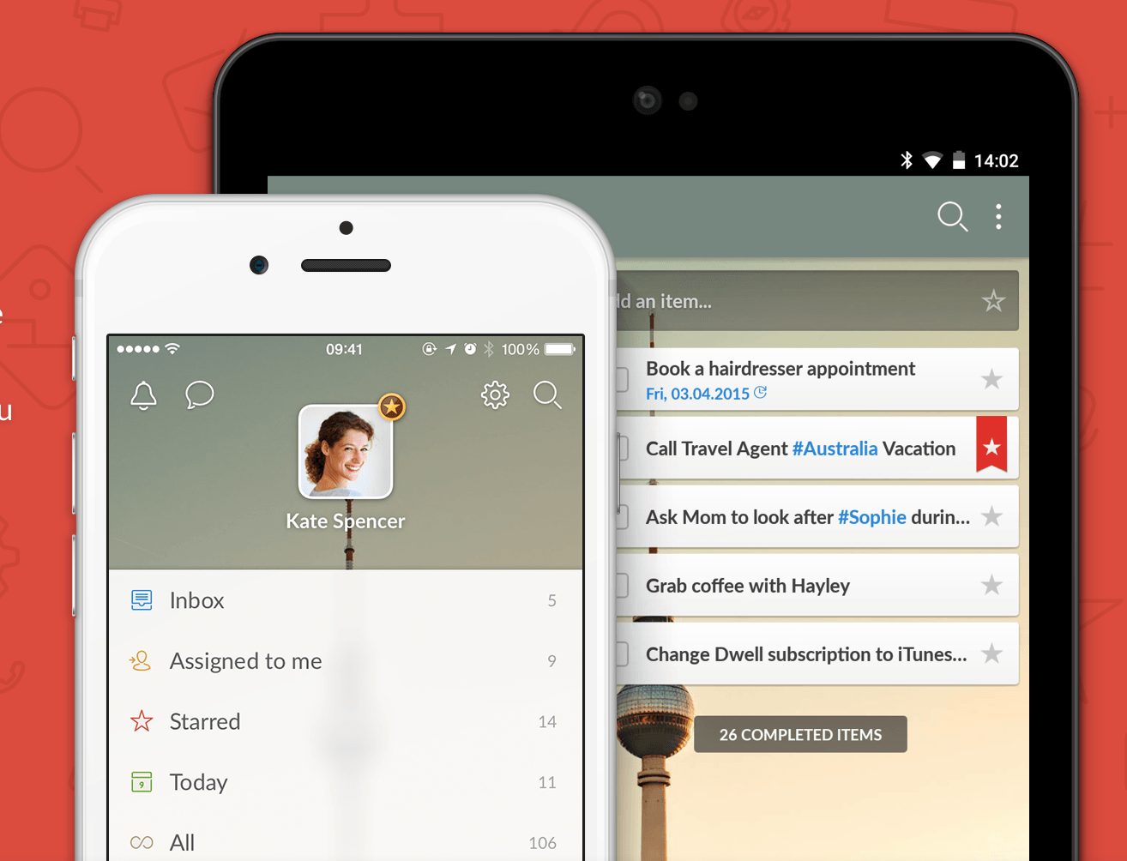
Wunderlist
The easiest way to get stuff done. Event planning, sharing a shopping list with a leader or managing multiple projects, Wunderlist is here to help you tick off all your personal and ministry to-dos.

Slide 42
Great Apps
Bible Gateway
YouVersion
Gabbit
Kahoot.it
Flipagram
Magisto
Pic Collage
Animoto

Slide 43
Communications Audit
A comprehensive evaluation of an organization's ability to send, receive and share information with various audiences within the organization.
Print mail and emails
Website
Social Media platforms
Logo
Top three goals? Priorities? Needs?
What could be more clear?
Where do you need more information?
What are they doing well?
Homework:
Connect with someone, agree on a date to complete and each of you do a communications audit for each other.

Slide 44

Desta Goehner
Director of Congregational Relations
Connect with me!
About.me/DestaG
Twitter & Instagram: @DestaG
Desta@CalLutheran.edu
#CLUconnect

